Slide 1



Micro Credit Project Case Study
November 5, 2022
Submitted by: Promise Azom

Slide 2
Outline
Data Description
EDA steps and Visualizations
Steps and Assumptions
Model Dashboard
Finalized Model & Conclusion

Slide 3

Data Description

Slide 4
Overall narrative summary of data: There are total 209,593 observation in our Micro Credit dataset .
There are total of 37 variables in our dataset.
We are going to be choosing 20 variables from the 37 variables. These variables are the features used.
Data contains no null values
Data contains numerical as well as categorical variable
1
2
3
4
5

Slide 5
Summary of Variables

Slide 6
Summary of Variables(Contd)

Slide 7

EDA STEPS
& VISUALIZATION

Slide 8
I employed both univariate, bivariate and multivariate analysis;
Plotted countplots, heatmaps, scatter plot and bar plots
Used only 20 features in the analysis because of the curse of dimensionality
I dropped 16 columns because they were not important in the analysis after applying SelectKBest
1
2
3
4

Slide 9

PROCESS STEPS & ASSUMPTIONS

Slide 10
I started by viewing the data and checking for null values;
I checked what kind of datatypes the dataset were made up of
I determined the target variable or labels.
I dropped irrelevant column – ‘Unamed: 0’
I choosed only 31 features using SelectKBest and finally used 20 features for the analysis after considering Multicollinearity
1
2
3
4
5

Slide 11
MODEL DASHBOARD

Slide 12
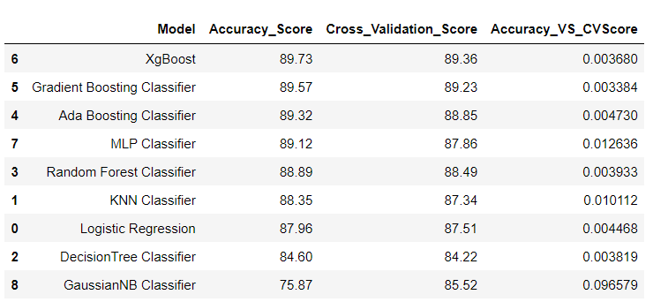
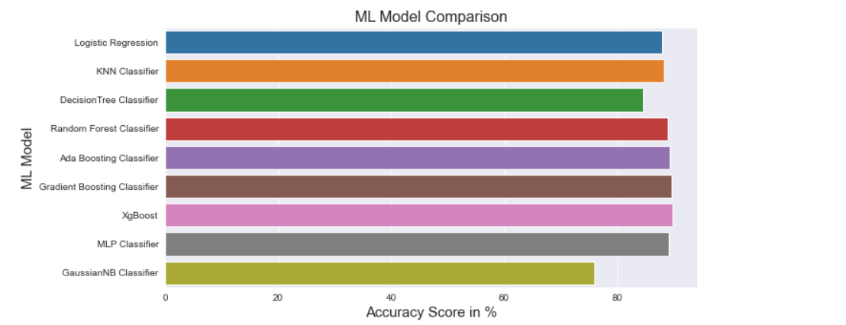
Comparing all Ten Models Built
Now from the above diagram it seems that XGBOOST Classifier(89.73%) has the highest Accuracy, However, our aim is to find the BEST MODEL, so if we consider the difference Between Accuracy_Score and Cross_Validation_Score....

Slide 13
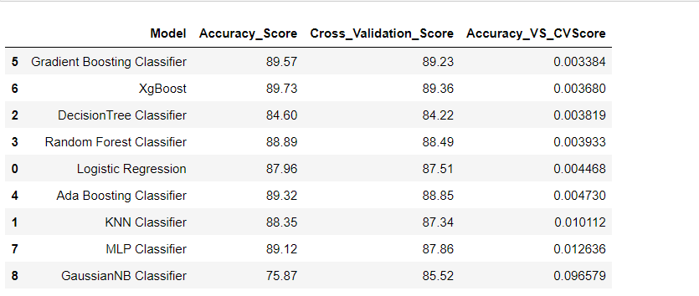
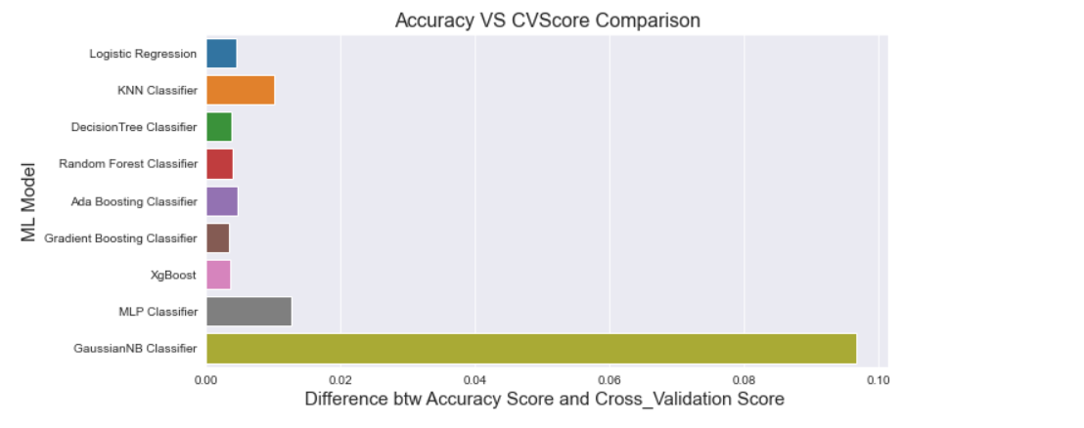
Comparing Differences between Accuracy and Cross_Validation Scores...
From the above we can see the Model with least difference is GRADIENT BOOSTING REGRESSOR!

Slide 14

Finalized Model & Conclusion

Slide 15
1
From the above we can see:
- The Model with least difference (0.003) between Accuracy Score and Cross Validation Score is GRADIENT BOOSTING REGRESSOR!
2
Accuracy is 89%
We also went further to engage in Hyperparamter Tunning using
GridSearchCV
3
FINAL ACCURACY after Hyperparameter Tunning: 90%
4

Slide 16
Thank You

